Slide 1
MSc Research Project: Progress
Sai Pemmaraju

Slide 2

Objectives Set in Previous Meeting (16/9/2022)
Set limit on Branching Fraction of $B^{0}→K^{∗0}a_{0}, a_{0}→γγ$
Compare the above limits to those in the existing literature
Plot signal selection efficiency curves for ALPs of varying masses

Slide 3

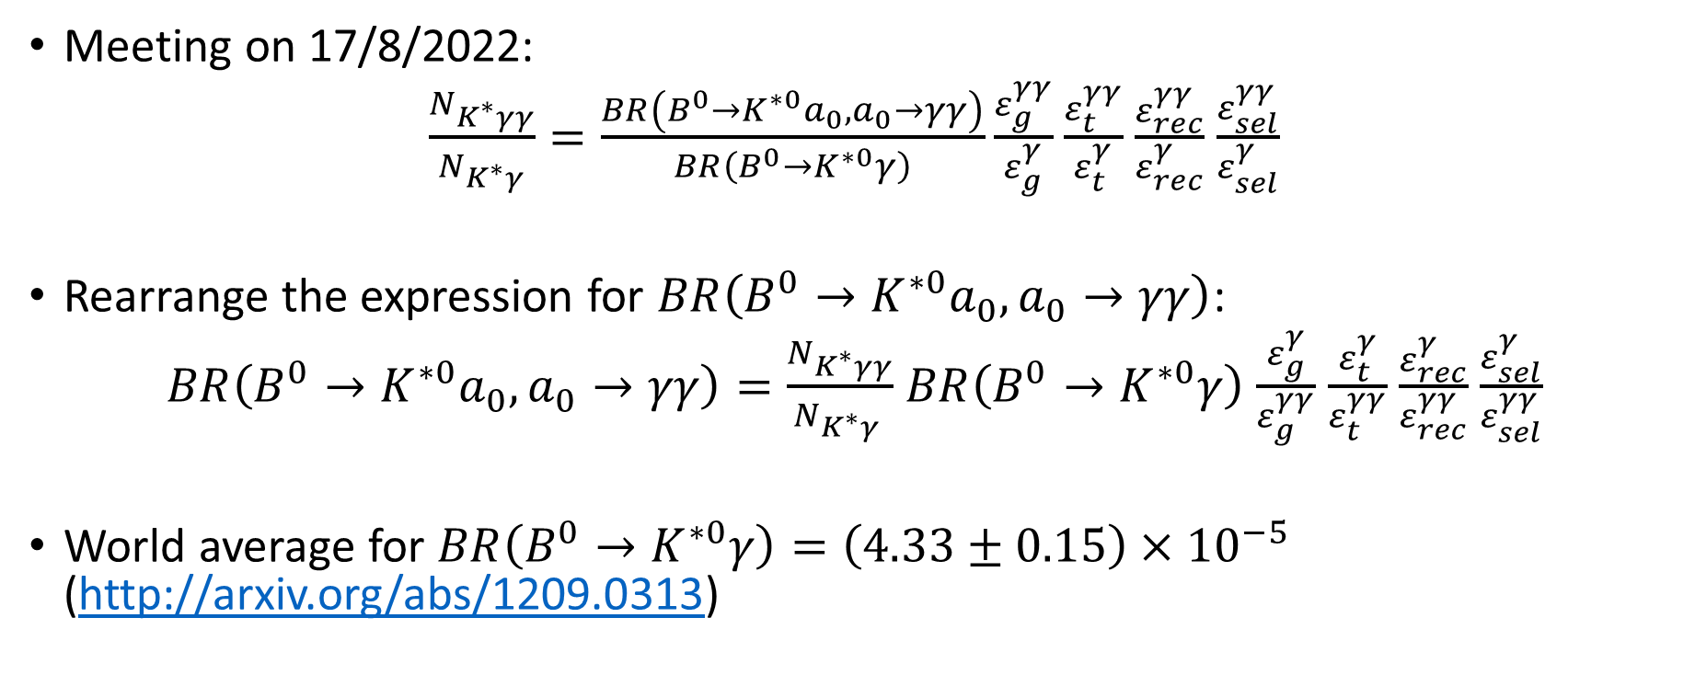
Limit on Branching Ratio of $B^{0}→K^{∗0}a_{0}, a_{0}→γγ$
Meeting on 17/8/2022:
$\frac{N_{K^{∗}γγ}}{N_{K^{∗}γ}}=\frac{BR\left(B^{0}→K^{∗0}a_{0}, a_{0}→γγ\right)}{BR\left(B^{0}→K^{∗0}γ\right)}\frac{ε_{g}^{γγ}}{ε_{g}^{γ}}$ $\frac{ε_{t}^{γγ}}{ε_{t}^{γ}}$ $\frac{ε_{rec}^{γγ}}{ε_{rec}^{γ}}$ $\frac{ε_{sel}^{γγ}}{ε_{sel}^{γ}}$
Rearrange the expression for $BR\left(B^{0}→K^{∗0}a_{0}, a_{0}→γγ\right)$:
$BR\left(B^{0}→K^{∗0}a_{0}, a_{0}→γγ\right)=\frac{N_{K^{∗}γγ}}{N_{K^{∗}γ }}$ $BR\left(B^{0}→K^{∗0}γ\right)$ $\frac{ε_{g}^{γ}}{ε_{g}^{γγ}}$ $\frac{ε_{t}^{γ}}{ε_{t}^{γγ}}$ $\frac{ε_{rec}^{γ}}{ε_{rec}^{γγ}}$ $\frac{ε_{sel}^{γ}}{ε_{sel}^{γγ}}$
World average for $BR\left(B^{0}→K^{∗0}γ\right)=\left(4.33±0.15\right)×{10}^{−5}$ (http://arxiv.org/abs/1209.0313)

Slide 4
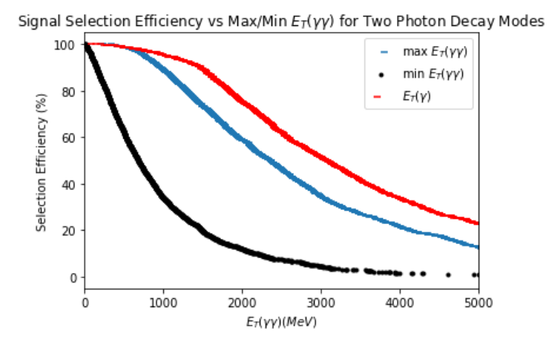
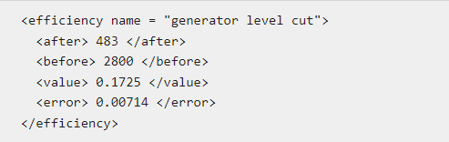
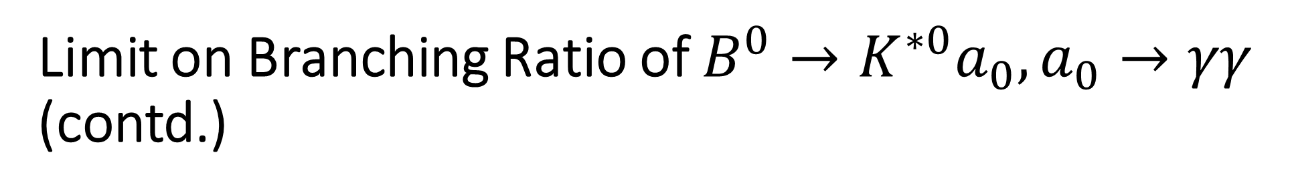
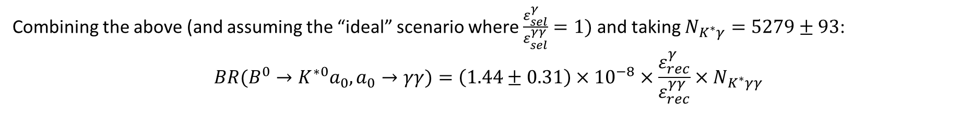
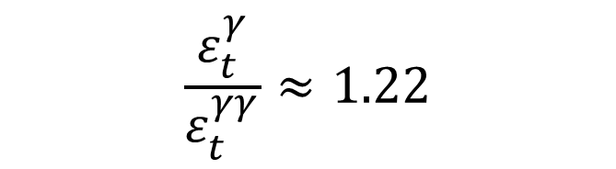


Limit on Branching Ratio of $B^{0}→K^{∗0}a_{0}, a_{0}→γγ$ (contd.)
$$\frac{ε_{t}^{γ}}{ε_{t}^{γγ}}≈1.22$$
$$\frac{ε_{g}^{γ}}{ε_{g}^{γγ}}=\frac{0.2479}{0.1725}≈1.44$$
$$E_{T}\left(γ\right)>2.6 GeV$$
Combining the above (and assuming the “ideal” scenario where $\frac{ε_{sel}^{γ}}{ε_{sel}^{γγ}}=1)$ and taking $N_{K^{∗}γ}=5279±93$:
$${BR(B}^{0}→K^{∗0}a_{0}, a_{0}→γγ)=\left(1.44±0.31\right)×{10}^{−8}×\frac{ε_{rec}^{γ}}{ε_{rec}^{γγ}}×N_{K^{∗}γγ}$$

Slide 5
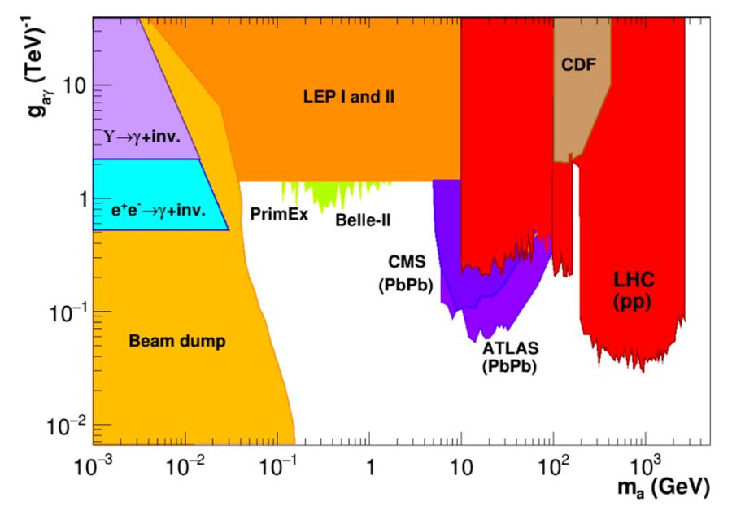
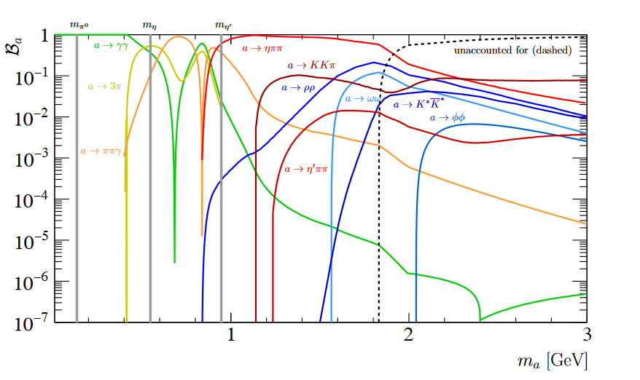

Comparison of Branching Ratio to Plots in the Existing Literature
$${BR(B}^{0}→K^{∗0}a_{0}, a_{0}→γγ)=\left(1.44±0.31\right)×{10}^{−8}×\frac{ε_{rec}^{γ}}{ε_{rec}^{γγ}}×N_{K^{∗}γγ}$$
http://arxiv.org/abs/2102.08971
https://journals.aps.org/prl/supplemental/10.1103/PhysRevLett.123.031803/supplemental.pdf

Slide 6
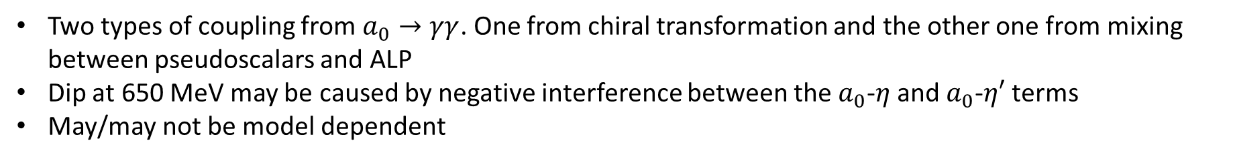
Two types of coupling from $a_{0}→γγ$. One from chiral transformation and the other one from mixing between pseudoscalars and ALP
Dip at 650 MeV may be caused by negative interference between the $a_{0}$-$η$ and $a_{0}$-$η′$ terms
May/may not be model dependent

Slide 7
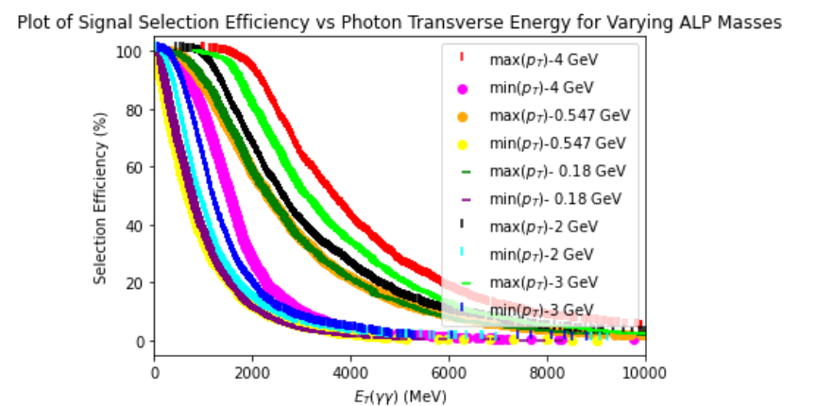
Signal Selection Efficiency Curves for ALPs of Varying Masses

Slide 8
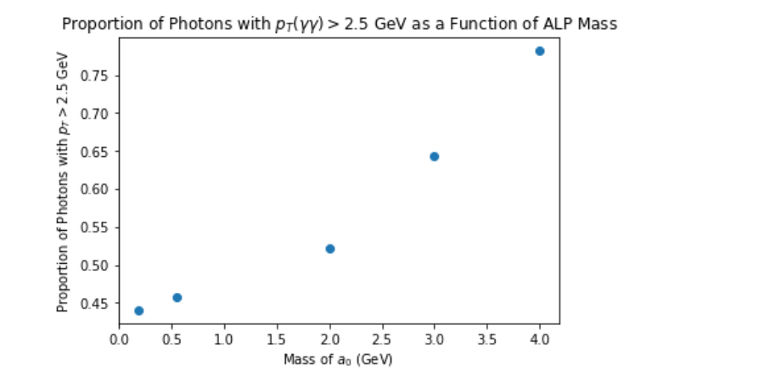
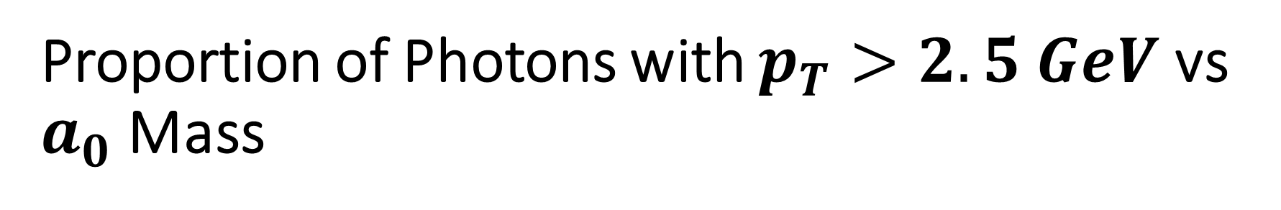
Proportion of Photons with $p_{T}>2.5 GeV$ vs $a_{0}$ Mass

Slide 9

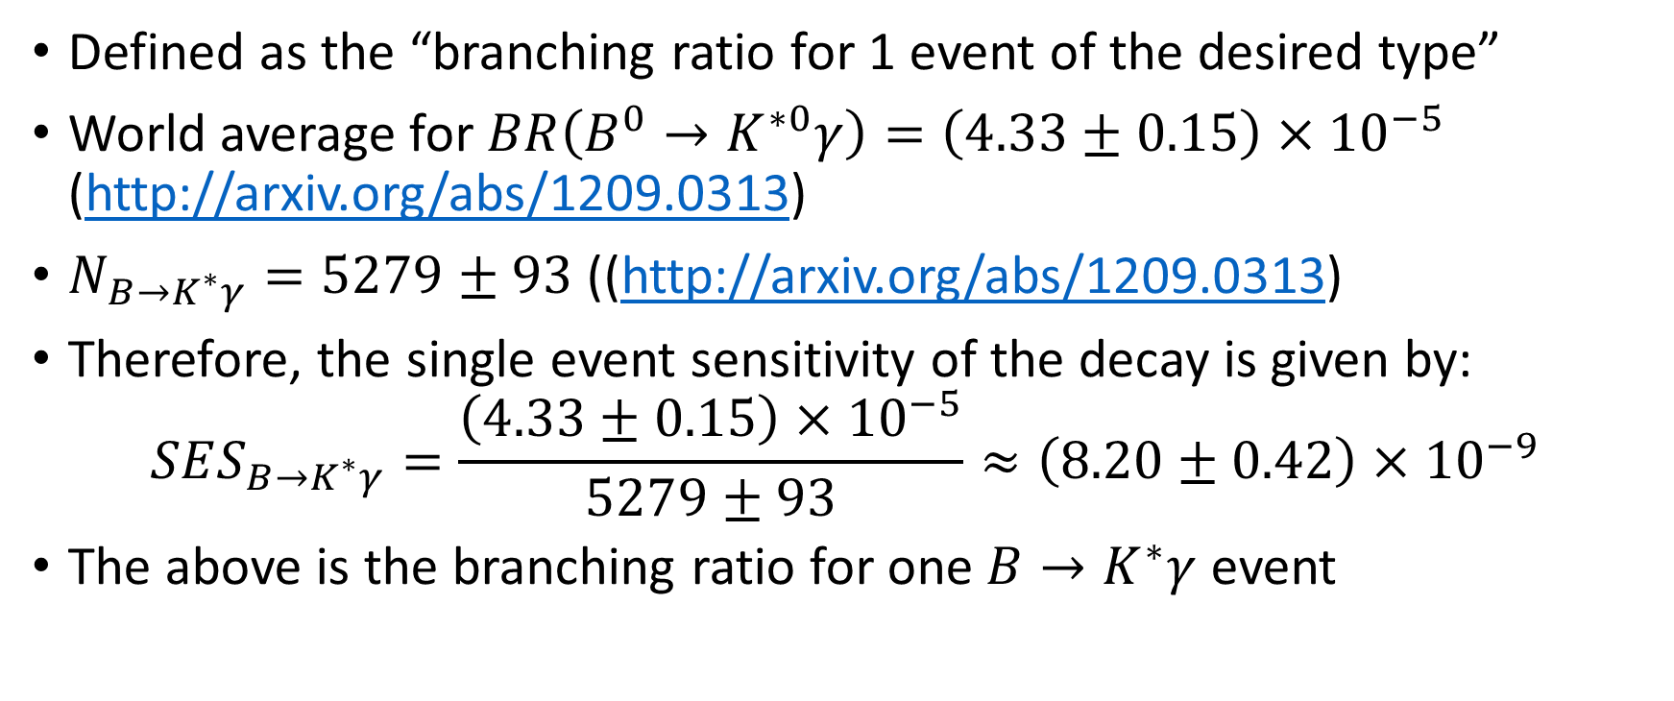
Single Event Sensitivity of $B^{0}→K^{0∗}γ$
Defined as the “branching ratio for 1 event of the desired type”
World average for $BR\left(B^{0}→K^{∗0}γ\right)=\left(4.33±0.15\right)×{10}^{−5}$ (http://arxiv.org/abs/1209.0313)
$N_{B→K^{∗}γ}=5279±93$ ((http://arxiv.org/abs/1209.0313)
Therefore, the single event sensitivity of the decay is given by:
$$SES_{B→K^{∗}γ}=\frac{\left(4.33±0.15\right)×{10}^{−5}}{5279±93}≈\left(8.20±0.42\right)×{10}^{−9}$$
The above is the branching ratio for one $B→K^{∗}γ$ event

Slide 10
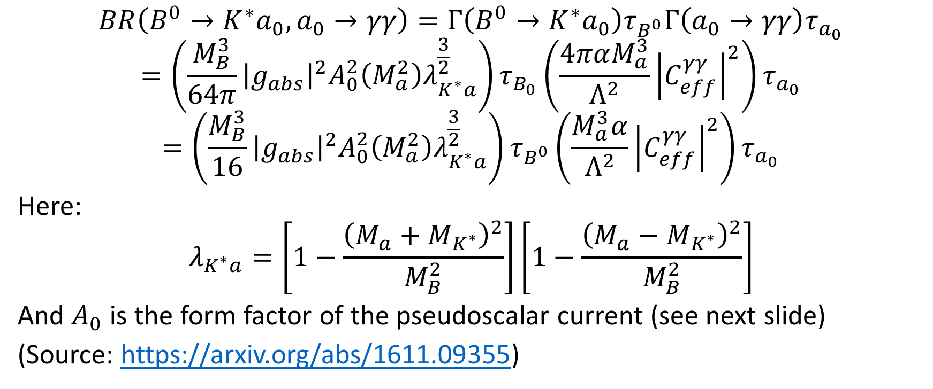
Link Between Branching Ratio, Coupling Strength and Mass of ALP
$$BR\left(B^{0}→K^{∗}a_{0}, a_{0}→γγ\right)=Γ\left(B^{0}→K^{∗}a_{0}\right)τ_{B^{0}}Γ\left(a_{0}→γγ\right)τ_{a_{0}}$$
$$=\left(\frac{M_{B}^{3}}{64π}{\left|g_{abs}\right|}^{2}A_{0}^{2}\left(M_{a}^{2}\right)λ_{K^{∗}a}^{\frac{3}{2}}\right)τ_{B_{0}}\left(\frac{4παM_{a}^{3}}{Λ^{2}}{\left|C_{eff}^{γγ}\right|}^{2}\right)τ_{a_{0}}$$
$$=\left(\frac{M_{B}^{3}}{16}{\left|g_{abs}\right|}^{2}A_{0}^{2}\left(M_{a}^{2}\right)λ_{K^{∗}a}^{\frac{3}{2}}\right)τ_{B^{0}}\left(\frac{M_{a}^{3}α}{Λ^{2}}{\left|C_{eff}^{γγ}\right|}^{2}\right)τ_{a_{0}}$$
Here:
$$λ_{K^{∗}a}=\left[1−\frac{{\left(M_{a}+M_{K^{∗}}\right)}^{2}}{M_{B}^{2}}\right]\left[1−\frac{{\left(M_{a}−M_{K^{∗}}\right)}^{2}}{M_{B}^{2}}\right]$$
And $A_{0}$ is the form factor of the pseudoscalar current (see next slide)
(Source: https://arxiv.org/abs/1611.09355)

Slide 11
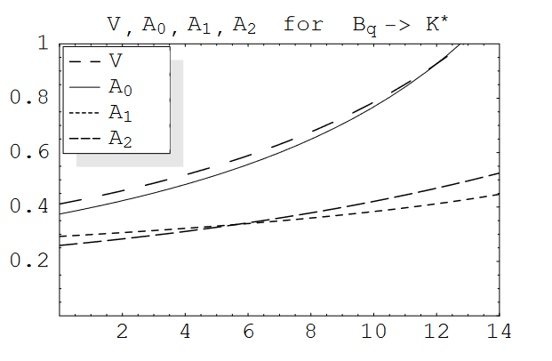
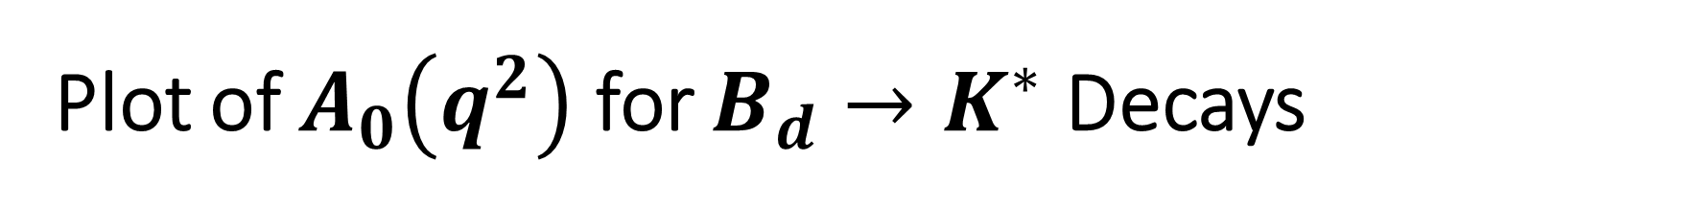
Plot of $A_{0}\left(q^{2}\right)$ for $B_{d}→K^{∗}$ Decays
$$BR\left(B^{0}→K^{∗}a_{0}, a_{0}→γγ\right)= \left(\frac{M_{B}^{3}}{16}{\left|g_{abs}\right|}^{2}A_{0}^{2}\left(M_{a}^{2}\right)λ_{K^{∗}a}^{\frac{3}{2}}\right)τ_{B^{0}}\left(\frac{M_{a}^{3}α}{Λ^{2}}{\left|C_{eff}^{γγ}\right|}^{2}\right)τ_{a_{0}}$$
Source: https://arxiv.org/pdf/hep-ph/0412079.pdf

Slide 12
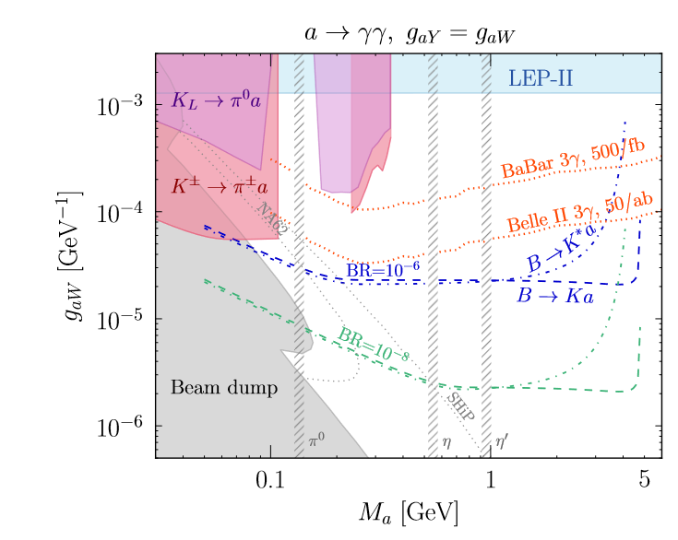
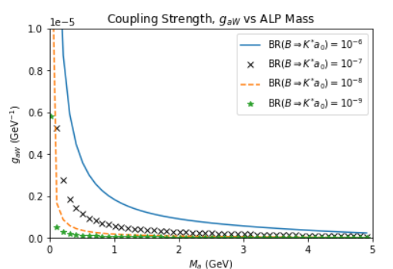
Coupling Strength vs ALP Mass (fixed Branching Ratio)

Slide 13

Objectives Set in Previous Meeting (9/11/2022)
Find plot of BR = ${10}^{−7}$ on $m_{a}$ vs $g_{aW}$ plot
Literature Review (in progress)

Slide 14
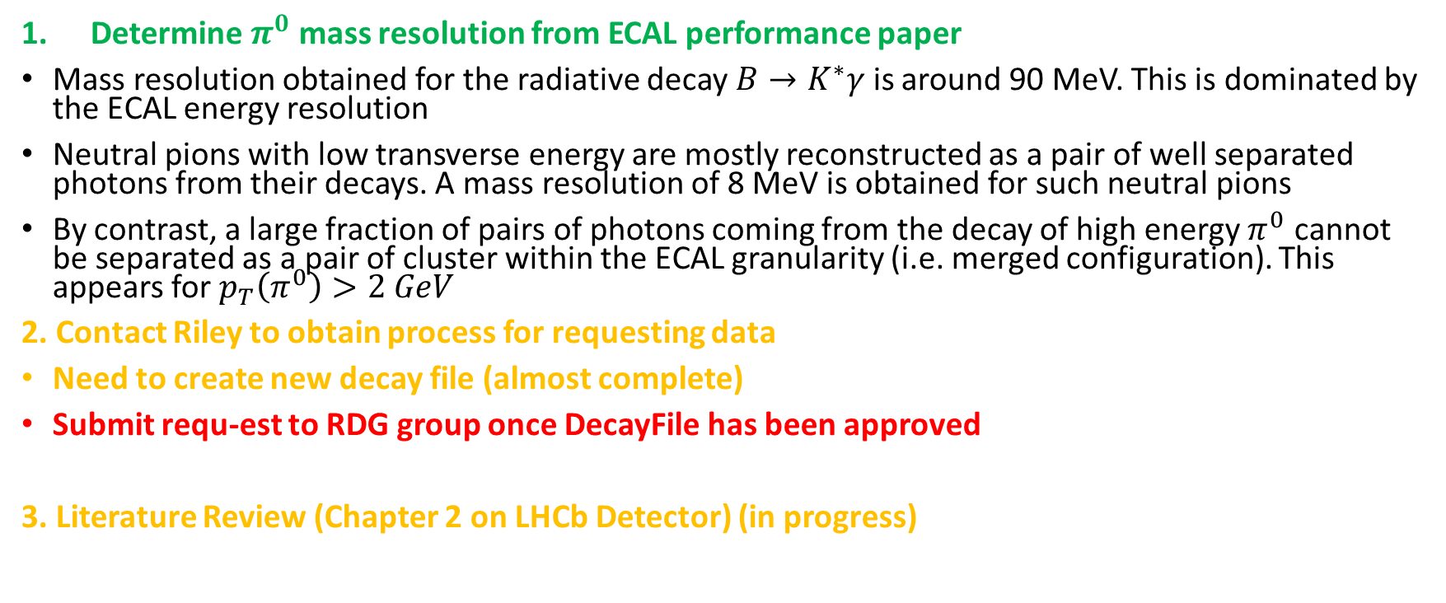
Objectives Set in Previous Meeting (16/09/2022)
Determine $π^{0}$ mass resolution from ECAL performance paper
Mass resolution obtained for the radiative decay $B→K^{∗}γ$ is around 90 MeV. This is dominated by the ECAL energy resolution
Neutral pions with low transverse energy are mostly reconstructed as a pair of well separated photons from their decays. A mass resolution of 8 MeV is obtained for such neutral pions
By contrast, a large fraction of pairs of photons coming from the decay of high energy $π^{0}$ cannot be separated as a pair of cluster within the ECAL granularity (i.e. merged configuration). This appears for $p_{T}\left(π^{0}\right)>2 GeV$
2. Contact Riley to obtain process for requesting data
Need to create new decay file (almost complete)
Submit requ-est to RDG group once DecayFile has been approved
3. Literature Review (Chapter 2 on LHCb Detector) (in progress)

